Slide 1
Introduction to Statistics

Slide 2
What is Statistics?
Statistics involves estimation, inference and study design.
Estimation is about trying to work out how large or small something is.
Inference is about drawing conclusions
Statisticians usually make inference by testing hypothesis.
A hypothesis is a statement about the world that could be tested to see whether it is true or false.
Design a study is very complicated. Statisticians often have a lot to say about HOW EXACTLY a study should be designed.

Slide 3
Statistics and Data
“If the rats are dirty, so will my data be”
R.A. Fisher
“There are lies, damned lies and statistics”
Who said that?

Slide 4
Means and Medians
What most people call an “average” is what statisticians call a mean.
The median is half way point of your list of number.
Please figure out algorithms to calculate mean and median.

Slide 5
Outlier
An outlier is when you have an observation that does not follow the pattern of the data.
When you have outliers, the median often gives a fair reflection of the data than the mean.
Generally speaking, means are better than medians for planning and making decision.

Slide 6
Question
Here is a die rolling game:
You roll a die and if you get 1-5, I give you $20; if you roll a 6, you give me $1,000. Would you play? Explain your answer.

Slide 7
Standard Deviation and Interquartile Range
A person had his head in oven and his feet in the fridge. He said, “on average, pretty good”.
You generally want to know more than average of a data set.
How much the data vary around that average: a measure of spread
The measure of spread normally reported with a mean is the standard deviation;
The measure of spread normally reported with a median is the interquartile range.

Slide 8
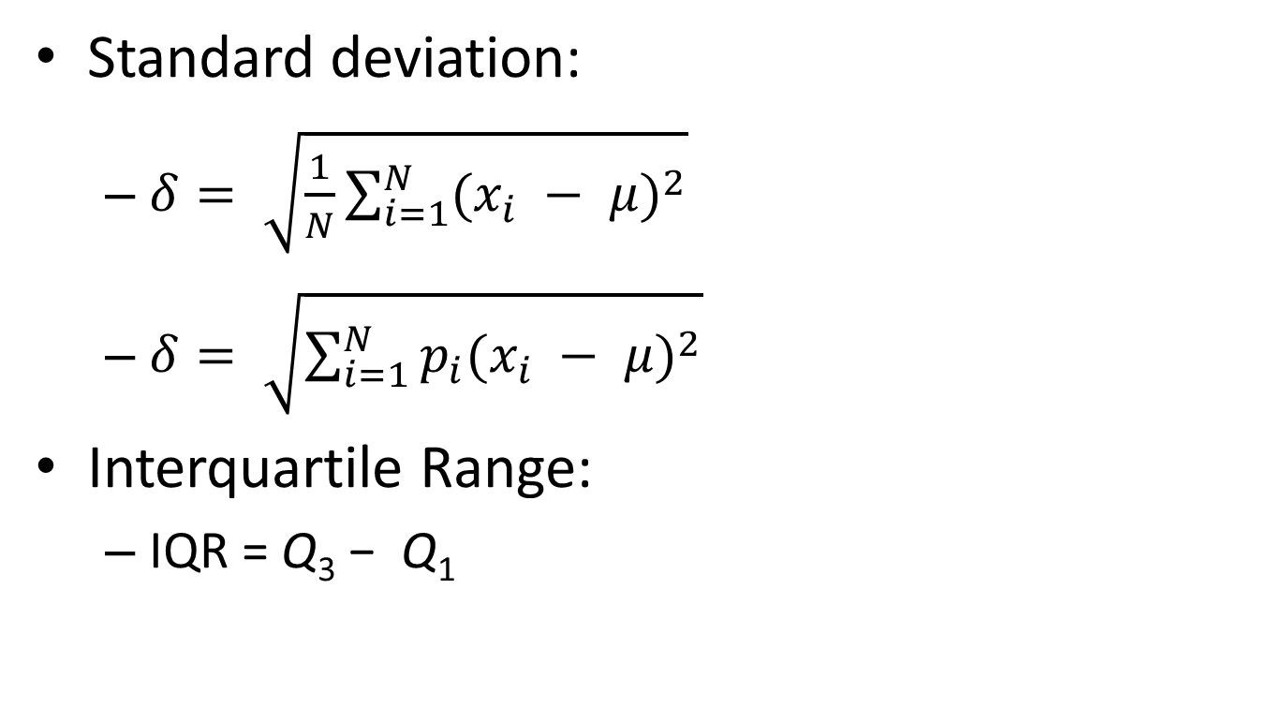
Standard Deviation and Interquartile Range
Standard deviation:
$δ= \sqrt{\frac{1}{N}\sum_{i=1}^{N}{{(x_{i} − μ)}^{2}}}$
$δ= \sqrt{\sum_{i=1}^{N}{p_{i}{(x_{i} − μ)}^{2}}}$
Interquartile Range:
IQR = Q₃ − Q₁

Slide 9
Standard Deviation
A list of array
2, 4, 4, 4, 5, 5, 7, 9
What is the mean?
What is the standard deviation?

Slide 10
Standard Deviation
If the Standard Deviation is small, that means everyone is close to mean;
If the Standard Deviation is large, that means everyone vary widely.

Slide 11
Standard Deviation
Some well-known rules
“95% of observations are within about two standard deviation of the mean” (1.96)
“two-thirds of observations are within one standard deviation from the mean”
“About half of observations are within two-thirds standard deviation from the mean”
Verify based on previous example

Slide 12
Interquartile Range
i | x[i] | Quartile
1 | 102
2 | 104
3 | 105 | Q₁
4 | 107
5 | 108
6 | 109 | Q₂ (median)
7 | 110
8 | 112
9 | 115 | Q₃
10 | 116
11 | 118
For the data in this table the interquartile range is IQR = 115 − 105 = 10.

Slide 13
Descriptive statistics
Everything we talked so far
Means
Medians
Standard deviations
Interquartile ranges
are known as descriptive statistics.
They are useful to describe a dataset.

Slide 14
On different types of Data
Lot of Static numbers (such as mean) do not occur on the dataset.
People sometimes choose particular number from the data as being illustrative (such as median).
Variables could be continuous or categorical.
Height; gender; income; race; years of education

Slide 15
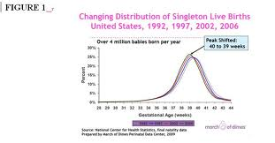
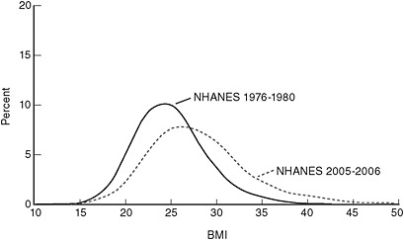
Skewed shot
Skew means “off to one side”. It has two reasons,
You have more observations on one side than the other. (BMI distribution and Gestation time)

Slide 16
Skewed shot
Another meaning of skew is “skewed away from the truth”.
Example of Frank Roosevelt's re-election in 1936
The pool was based on phone book
Response rate was low
Thus, the study was biased
You can also get bias even if you select your sample carefully and fairly
How do you phase your question?

Slide 17
Bias
There are numerous types of bias.
I will not ask you to remember their name here
But
Skew is out there as part of the world
Bias is what can sometime introduce when we study the world, but in most case, we should try to avoid the bias.

Slide 18
How to Draw a Graph
X axis and y axis
The thing we want to understand can be called y.
The thing we use to understand y is called x.
Making a point at the x and y of each observation, is called a scatterplot.
One big challenges of statistics is to find the fitting functions. Those could be polynomial or non-linear.
Related methods: interpolation or smoothing
Related topic: regression analysis

Slide 19
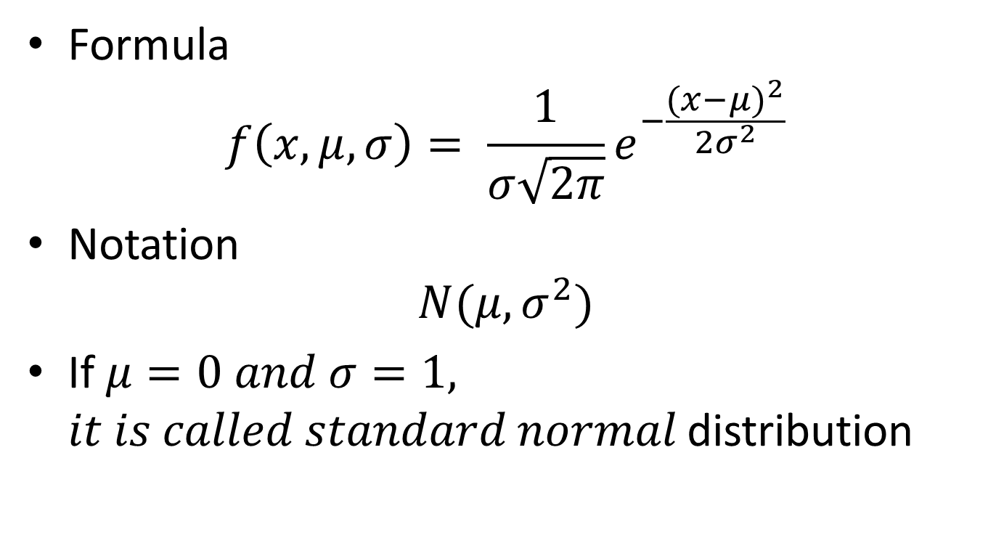
Normal Distribution
Formula
$$f\left(x, μ, σ\right)= \frac{1}{σ\sqrt{2π}}e^{−\frac{{(x−μ)}^{2}}{2σ^{2}}}$$
Notation
$$N(μ, σ^{2})$$
If $μ=0 and σ=1,$ $it is called standard normal$ distribution

Slide 20
Normal Distribution
How to understand
The normal distribution is what you get when you add up a large number of random events
The normal distribution describes the variation of many natural phenomena, such as hemoglobin levels.
The normal distribution also describes the variation in results of a study, were we repeat it many times.

Slide 21
Data in Normal Distribution is NOT Normal
It is normal for you to see error data and missing data
You rarely see a normal distribution in some areas of statistics.
Some reasons:
Sampling variance
Some data are not Normal

Slide 22
Data in Normal Distribution is NOT Normal
Normal distributions are rare when the data come not from the whole population, but from a special sample, such as medical patients
The distribution of data depends on the underlying process creating the data.
Many phenomena result from the multification of random events
Logarithms change multiplication into addition.
Thus, non-normal distributions are changed into normal distribution.
Log will NOT solve all the problem.

Slide 23
Statistical Analysis
Textbook version
Take a look at data
Test whether or not it is close to certain statistical distribution
Decide how to analyze it
If Normal distribution
Using T-test
Else
Use the Wilcoxon

Slide 24
Statistical Analysis
In real world, there is no clear rules for determining whether a data set is close enough to the normal distribution to make it reasonable to use statistical procedures that assume normality.
It is a judgment call (subjective) on whether the method provides a “good enough” approximation.

Slide 25
Variations
There are two sorts of variations.
One is natural variation that can be observed
The other is the variation of study results (theoretical variation), when a study is repeated.
It is not easy to evaluate because repeating is expensive.
It is major task for statisticians.

Slide 26
Variations
Standard deviation is used to describe the natural variation of something you can measure.
Standard error is used to describe the variation of study results – a statistic such as a mean or proportion calculated from study data – imagining hypothetically you were to repeat a study many times.
The variation of study results often follows a normal distribution, even it the data from each individual are non-normal.

Slide 27
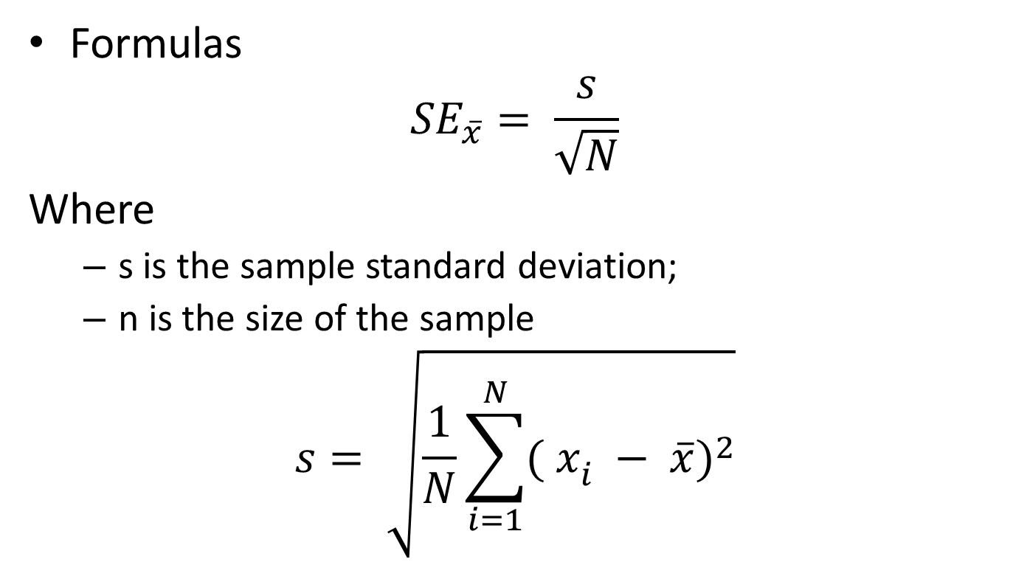
Standard Errors
Formulas
$${SE}_{\overline{x}}= \frac{s}{\sqrt{N}}$$
Where
s is the sample standard deviation;
n is the size of the sample
$$s= \sqrt{\frac{1}{N}\sum_{i=1}^{N}{{( x_{i}^{} − \overline{x})}^{2}}}$$

Slide 28
Variations
The standard error of the mean (SEM) is the standard deviation of those sample means over all possible samples (of a given size) drawn from the population.
Secondly, the standard error of the mean can refer to an estimate of that standard deviation, computed from the sample of data being analyzed at the time.

Slide 29
Variations
The standard error of the sample is an estimate of how far the sample mean is likely to be from the population mean, whereas the standard deviation of the sample is the degree to which individuals within the sample differ from the sample mean.
If the population standard deviation is finite, the standard error of the sample will tend to zero with increasing sample size, because the estimate of the population mean will improve, while the standard deviation of the sample will tend to the population standard deviation as the sample size increases.

Slide 30
Variations
It is all about guess right.
If we take a sample of individuals, 95% will have values within 2 standard deviations of the mean. This is called the reference range.
If we repeated a study a large number of times, 95% of the estimates would be within 2 standard errors of the true mean; it is called the confidence interval.

Slide 31
Variations
Reference ranges are only used for some specific purposes, such as identifying patients with blood values suggestive of disease. Reference ranges are not usually reported in scientific papers.
Confidence intervals are useful way of thinking what the results of a study might plausible be, were you repeat it.

Slide 32
Margin of Error
The idea of a margin of error makes it sound as though the true result could be absolutely anywhere within the confidential interval.
In fact, it is more likely to be nearer the middle of the confidence interval than at either extreme
A “statistical tie” means that the confidence interval includes no difference

Slide 33
How Well Do the Methods Work
Different methods often produce different – and sometime contradictory – results
Lots of reasons for that.
No methods is perfect

Slide 34
How Well Do the Methods Work
It is useful to be able to measure the overall accuracy of methods, and a number of attempts have been made at estimating their performance.

Slide 35
How Well Do the Methods Work
Four possible outcomes of a prediction:
True positive (TP)
Ture negative (TN)
Flase positive (FP)
Flase negative (FN)

Slide 36
How Well Do the Methods Work
Predicted
Actual
 | Positive | Negative
Positive | TP | FN
Negative | FP | TN

Slide 37
How Well Do the Methods Work
Sensitivity(Sn): Sensitivity is defined as positive results that has been predicted correctly
Sensitivity (Sn) = TP/(TP + FN)

Slide 38
How Well Do the Methods Work
Specificity (Sp): Specificity is defined as the portion of Negative results of the prediction that is correct
Specificity (Sp) = TN / (TN + FP)

Slide 39
How Well Do the Methods Work
Question
For a perfect prediction, what is the value of Sn and Sp?

Slide 40
How Well Do the Methods Work
Correlation coefficient combines the sensitivity and specificity.
CC=[(TP x TN) – (FN x FP))]÷
sqrt[(TP+FN)(TN+FP)(TP+FP)(TN+FN)]
CC ranges from 1 to -1; where 1 means a prefect prediction; and a value of -1 indicates that every coding regions has been predicted as noncoding, and vice versa.

